Slide 1
A-server
DC-Automate Cloud Framework

Slide 2
A-Server
Private Cloud builder for ISV’s & Service providers
Offices in Belgium, USA, India & Egypt
Team 15 years experience in datacenters & storage
Delivering Worldwide ready to go clouds!

Slide 3
A-server is born out of Incubaid
Success Stories
Dedigate (2000) -> Sold to Terremark in 2005: complex hosting
Hostbasket (2000) -> Sold to Telenet in 2004: SMB hosting
DCT (2002) -> Sold to Symantec in 2005 : CAS storage system
Virtualbox -> Sold to SUN in 2008 : Hypervisor
Qlayer (2005) -> Sold to SUN in 2009 : Cloud System
Active Companies Today
A-server (2005) -> HQ in India, active in US, Europe & Egypt Cloud company competing with Amazon, Creator of SSO (Private Cloud Solution for SMB companies)
Racktivity (2008) -> improve update and power consumption in datacenters
Dacentec (2009) -> ultra green datacenter in US
(next to google datacenter in north Carolina).
Incubaid main activity is high tech (IT) mainly focused around datacenters & infrastructure software.

Slide 4
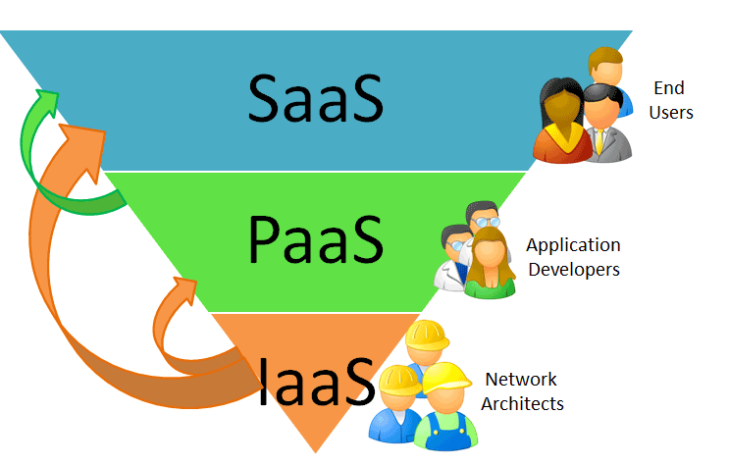
Cloud computing Pyramid
© 2009 – Aserver

Slide 5

Infrastructure as a Service ...
Datacenter Auto Provisioning
Scalability
Redundant Storage Architecture
Control Panels & API’s
Self-Healing

Slide 6

Public clouds will not suit all ...
Service Level Agreement?
Reliability?
Security?
Disaster Recovery?
Control?
Where is my data stored?
Performance?

Slide 7
Cloud Computing Evolution
LEVEL OF
ABSTRACTION
Software Development
In Cloud
Disconnected
From Reality
Need For ERP
Approach.
Abstracted
Services
(Storage,
DB, …)
e.g. Google
APP Engine
Abstracted
APPS
SLA
Managed
Servers (*) & Applications
Abstracted
Virtual
Datacenter
e.g. Amazon,
Nirvanix, SUN, EMC Mozy,
Mosso, Oracle, …
Hardware
In Racks
e.g. Rightscale, GigaSpaces, …
TIME
(*) could be virtual

Slide 8
Requirements IAAS = Infrastructure As A Service
100% agility (change in minutes)‏
Customers can self manage & deploy
ERP alike System Mgmt Approach
automated capacity planning
charge back mechanism
infrastructure neutral
works on top of any server, network, storage, virtualization system
multi tenant & resell capabilities
multiple levels of service providers sells into other service providers
100%
40%
0%
50%
30%
10%
10%
State Of Market
And Technology.

Slide 9
Learn From Warehouses & ERP
Warehouse
Employees
Execute Actions
Measure
Monitor
(e.g. RFID)‏
REALITY
Pallets
racks
Workflow
Engine
Processes
Knowledge
Complete
Expandable
ERP
System
Interface
MODEL
Customer
Asks Action
Interfaces to External World: SOAP, EDI, … + Communication to 3e parties

Slide 10
Generation 1 Datacenter Staff works directly on infrastructure, little automation, costly to scale
Datacenter
Employees
Execute Actions
Measure
Monitor
REALITY
Agent
racks
almost never done
Customer
Asks Action
Scripts
People are the interface + control panels talk to the scripts or api’s on top of apps.

Slide 11
Generation 2 Datacenter Some workflows automated, Still too labor intensive, not a full ERP
Datacenter
Employees
Execute Actions
Measure
Monitor
REALITY
Agent
racks
Customer
Asks Action
Workflow
Engine
Processes
Knowledge
Scripts
Through
Controls …
Optional Configuration Mgmt
Database
Interfaces to External World: SOAP, … + control panels with lot’s of knowledge inside.

Slide 12
IAAS Suggested Stack
Virtual Private Datacenter Layer
100% abstract, provisioning model
for True Cloud Computing
DRP = Datacenter Resource Planning
ERP system for the datacenter.
Model future reality
DAL = Datacenter Abstraction Layer
Translate model to reality
Management Tools
Manage Devices & Software
Work with reality e.g. CMDB
Hypervisors / Storage Virt. / IO Virt. / Network Virt.
The Virtual Reality
Physical Layer (Servers, Storage, Networking)‏
The Physical Reality

Slide 13
DC-Automate Complements
Virtual Private Datacenter Layer (VPDC) For Service Providers & End Users (define, sell, provision, control, visualize, bill, …)
DC-Automate
Datacenter Abstraction Layer (DAL) = Datacenter Model, Workflows, Development Framework (API)
VirtualCenter, Scalent, Cassat, Tivoli, …
Management Tools for applications & infrastructure.
VMware, XEN, Microsoft
CISCO, NetApp, Alcatel-Lucent …
Hypervisors: e.g. VMware ESX
IO / NetWork Virtualization
Physical Layer: Servers, Storage, Networking
EMC, Dell, HP, …

Slide 14
DC-Automate enabled.
Datacenter
Employees
Execute Actions
Measure
Monitor
REALITY
Agent
Racks
Workflow
Engine
Processes
Knowledge
Action
Scripts
DRP
GUI - Portal
MODEL
Customer
Asks Action
Interfaces to External World: SOAP, … + Communication to 3e parties

Slide 15





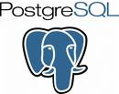







Datacenter Abstraction Layer
Snapshot
Create
Start/Stop
Import/Export
Backup/Restore
Reboot
Move
Destroy
DC-Automate DAL
Hypervisor

Slide 16
Challenges
End-users need instant availability of IT resource.
Remote IT managers, software developers, system administrators, project managers… all rely on IT helpdesk for datacenter resources. It should be possible to provision new virtual resources within minutes (storage, network & processing capacity).
Capacity planning manual today.
Planning of centralized datacenter IT resources happens manual today. Very hard & time consuming to allocate resources to internal or external End-Users.
Chargeback to internal and external customers too difficult
Very hard to perform correct chargeback to internal customers (business units, projects) and external customers (e.g. for service providers).
IT staff overloaded with repetitive provisioning tasks
Highly qualified 3rd level engineers are overloaded with provisioning of new servers and applications and daily management tasks instead of focussing on their core role

Slide 17
What if you could…
Offload you senior engineers and delegate their repetitive tasks to helpdesk employees
Allow technical end-users to build their own virtual environment based on assigned virtual capacity
Allow non-technical end-users to provision new applications based on assigned credits

Slide 18
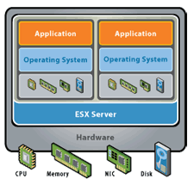

DC-Automate Management Model
Datacenter Model
(like ERP)‏
Operator
GUI
(CC)‏
Update Model
User Q-Portal
(VPDC)‏
Start Action
Framework
DAL
Knowledge
(=system plugins)‏

Slide 19
Custom Clouds Solution
DC-Automate can be used to quickly create a custom cloud solution.
We can integrate with all possible systems
All Servers & Hypvervisors
All Storage Systems
All Network Systems
All Automation & Provisioning Frameworks
All Billing Systems

Slide 20
DC-Automate has been used to create following products.
DAAS.com (Q4)
Competing solution with Amazon but more advanced and more reliable.
Smart Style Office
Private cloud solution for SMB market in US
Amplidata (OEM)
Unbreakable Storage System
Racktivity (OEM)
Power & Uptime management for datacenters
combination of hardware & software to save upto 80% of power in datacenters

Slide 21

Smart Style Office
SmartStyle Office is a virtualisation
turnkey solution with tightly
integrated software and
hardware to increase
the IT capacity and productivity
of SMBs

Slide 22
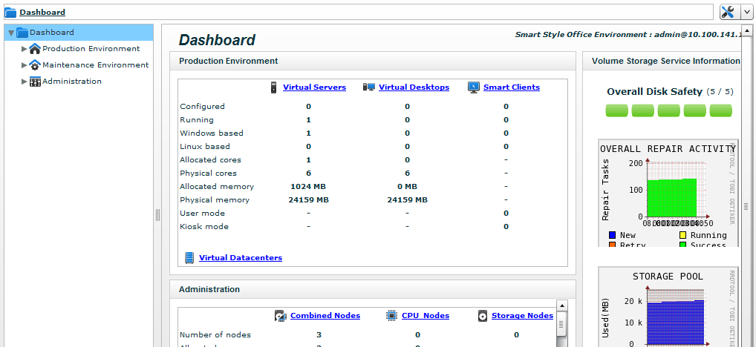
Smart Style Office
The simple and intuitive design
allows you to create virtual
servers and desktops from the
moment you plug it in

Slide 23
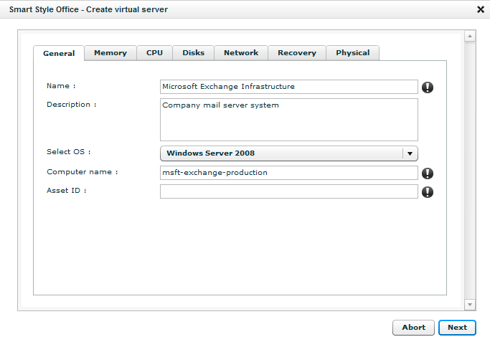
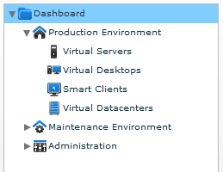
Smart Style Office
Create
virtual servers, virtual desktops and smart clients
Capacity Planning
Interface Functionality
Access to Flexible IT

Slide 24
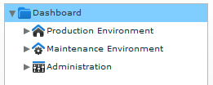
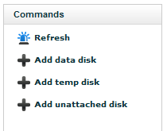
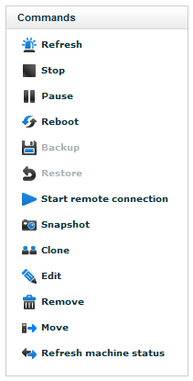
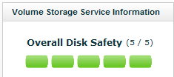
Smart Style Office
Manage
IT environments
Storage
Security
Capacity
Control

Slide 25
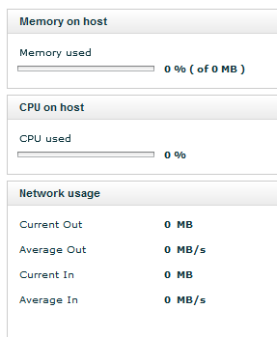
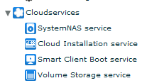
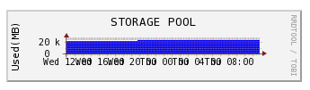
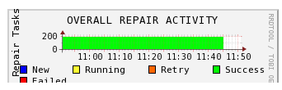
Smart Style Office
Monitor
IT activity and performance
Performance
Activity
Remote

Slide 26
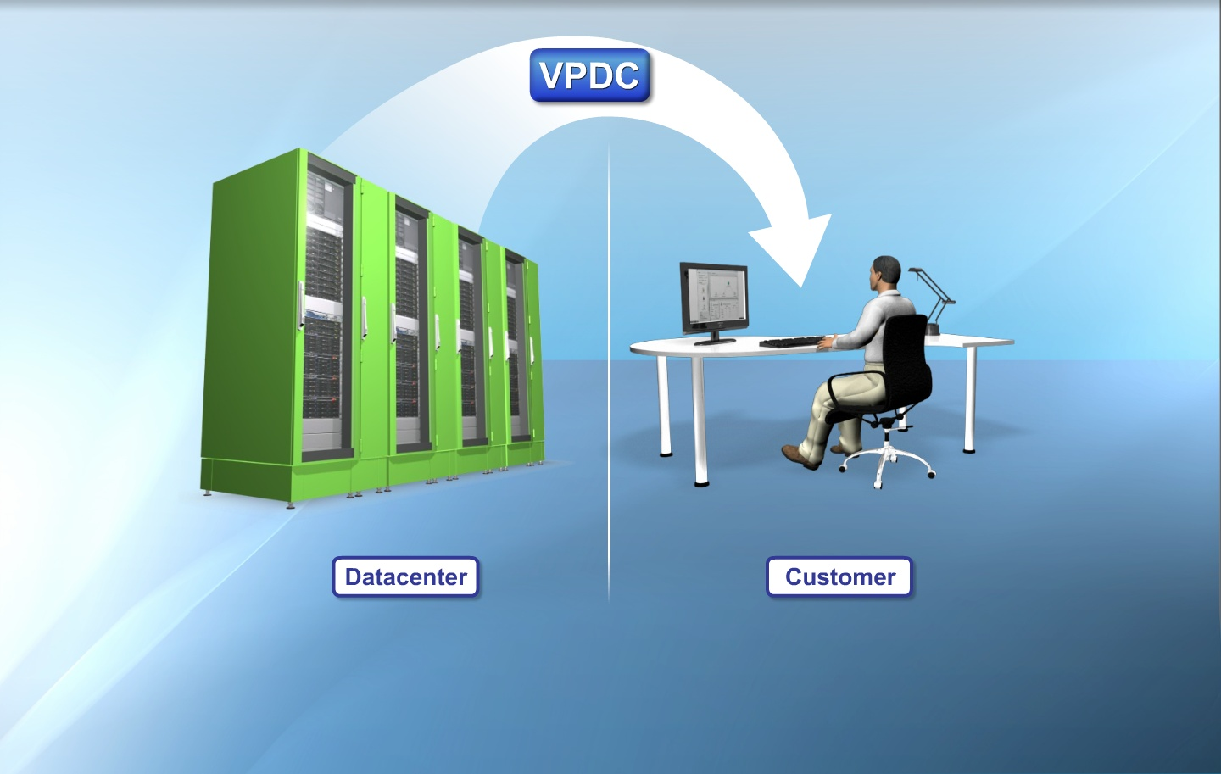

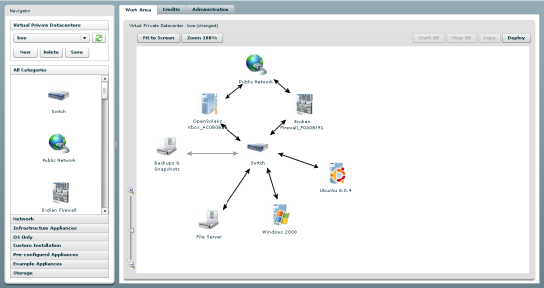
DAAS.com: Turnkey Solution

Slide 27
DAAS.com Product
Advanced Flash GUI
Auto-provisioning of VM’s, Storage & Networking
Unbreakable Storage Architecture
Self-Healing Capabilities & DR
Scalability of Resources
Extensive API’s
Built in Monitoring
And tons of extra features
A-Server - 2009

